Slide 1
Children’s Perceived Motor Competency: Reflections on partnering with PLASN-R Ruby Wheater

Slide 2
Overview
Overview of the research project
How I utilised ‘Reflective Practice (Gibbs Cycle)’
Working as a researcher /student within a school (College Park; St Mary’s) setting

Slide 3


My Background
Education
BSc Neuroscience, UCL
- Research in sleep and cognitive development
MSc Child Development, Institute of Education, UCL
Profession
Paediatric Clinical Physiologist (sleep and respiratory), Evelina Children’s Hospital London
Worked with children in various roles over the last 5 years
Notes:
I recently graduated from A Masters in child development at the Institute of Education where I worked alongside Spencer on my dissertation project, and before that I also did my undergraduate degree in Neuroscience at UCL.
I am currently working as a paediatric sleep and respiratory physiologist at the Evelina London children’s hospital, which involves running and analysing sleep studies for children with a range of sleep and respiratory disorders.
- I’ve worked with children for many years now, first as a dance teacher as well as doing some research whilst at school based in a resource based for deaf and hard of hearing children. I also have worked in various childcare roles alongside my degree. All of these experiences ultimately inspired me to want to study child development at masters level and I was particularly keen at being involved in research that aimed at looking at how we can support educational and daily living outcomes of autistic and neurodivergent children. I was lucky enough to get Spencer as my supervisor. He presented his research topics to me that focussed mainly around motor and literacy competencies in autistic children.

Slide 4
Main research questions
Approximately 87% of autistic children aged 5-15 experience motor difficulties
Visuo-motor integration (VMI): coordination of visual and motor information
important in learning outcomes such as handwriting, literacy and maths
Perceived motor competence: child’s perceptions of their own motor abilities
Unexplored in the autistic population
How does this concept relate to learning outcomes?
Research Questions
How do motor abilities, perceived motor competence, VMI and reading differ between autistic and non-autistic children?
What is the relationship between each of these measures?
Notes:
Motor difficulties are seen in approximately 87% of autistic children aged 5-15, impacting many different areas of fundamental movements, such as walking gait and balance, as well as manual dexterity and fine motor control, such as that required for manipulating objects, holding a pencil in school for example. The motor difficulties seen in autistic children can therefore have a real impact on daily living tasks, physical activity but also, due to many learning outcomes in KS1 relying on motor abilities, they can impact educational outcomes. Alongside this, autistic children have seen to have difficulties coordinating visual and motor information, known as Visuo-motor integration, which is known to be particularly important for educational outcomes including handwriting and literacy.
When doing some initial research into these topics I came across a literature review by Claire Cameron that mentioned how a child’s perception of their abilities may impact their development of skills related to literacy and I found this really interesting.
Perceived motor competence in short relates to how a child’s perceives their own ability to be in motor tasks. Previous work has focussed more on how this relates to physical activity, and it has been found that children who perceive themselves as less competent in motor skills are less likely to engage in activities, thereby reducing physical activity and opportunities to master skills
What I was interested in is how this concept relates to motor abilities that are more specific to literacy and educational outcomes.
So for this I looked at 4 main measures: actual motor competency, perceived motor competency, a test of visuo-motor integration, and word reading ability.
The main research questions were:
How do these 4 variables differ between autistic and non-autistic children in year 1 and year 2?
And what is the relationship between each of the measures too.

Slide 5
The research process
School integration
Piloting measures
15–20-minute sessions with each participant in a quiet room
Similar tasks grouped together for each session
Scoring and data analysis
Ethical approval
Notes:
Data collection:
I was mainly based in College park school where i worked with students in both Estela and Jake’s school
Before starting any data collection, and after we had received ethical approval, myself and Spencer went for a meeting with Tania and Estela from College park to discuss the research, for them to ask any questions and for us to explain what we might need from them and the students
This initial meeting allowed me to gauge how many participants would potentially consent to the study, as well as hae a clearer idea on the space i’d be using and what i might need from Estela.
After this, i spent 2-3 weeks in Estela’s class before collecting any data. I observed the classes, helped out where i could and soon felt like i was building a rapport with Estela, the TAs and arguably most importantly, the students themselves. Once consent forms had been sent out, i piloted a few of the measure with students. This gave me a good idea about how long they would take, what resources i might need, plus allowed me to practice how to communicate the instructions of the tasks so that it was appropriate for each child. From this as well i realised i should develop a bit of a script outline for some of the measurements, just so i know i am saying the right thinng and saying it clearly.
Reflecting on the piloting sessions, which i will discuss in more detail in a minute, also allowed me to aasses how i felt about being in this environment, and collecting data. I remember i had written that i felt a bit of imposter syndrome, and that i had sped through things quite quickly due to my own nerves

Slide 6
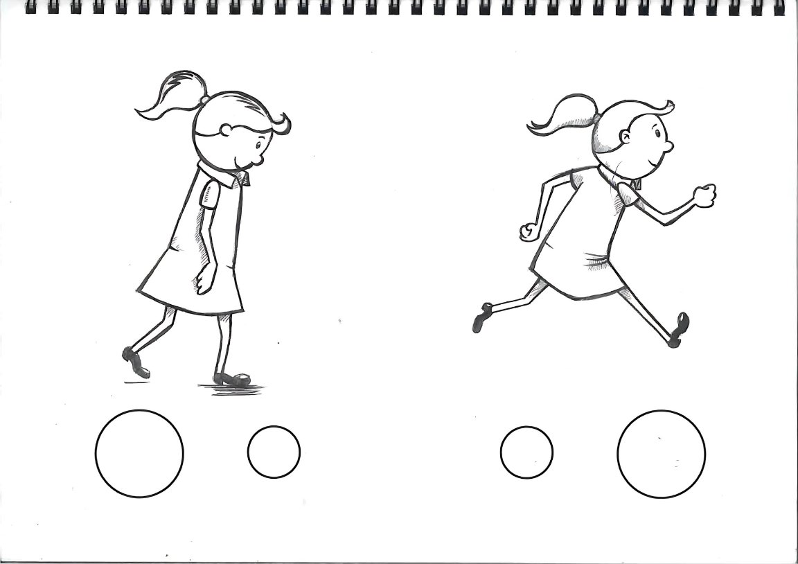
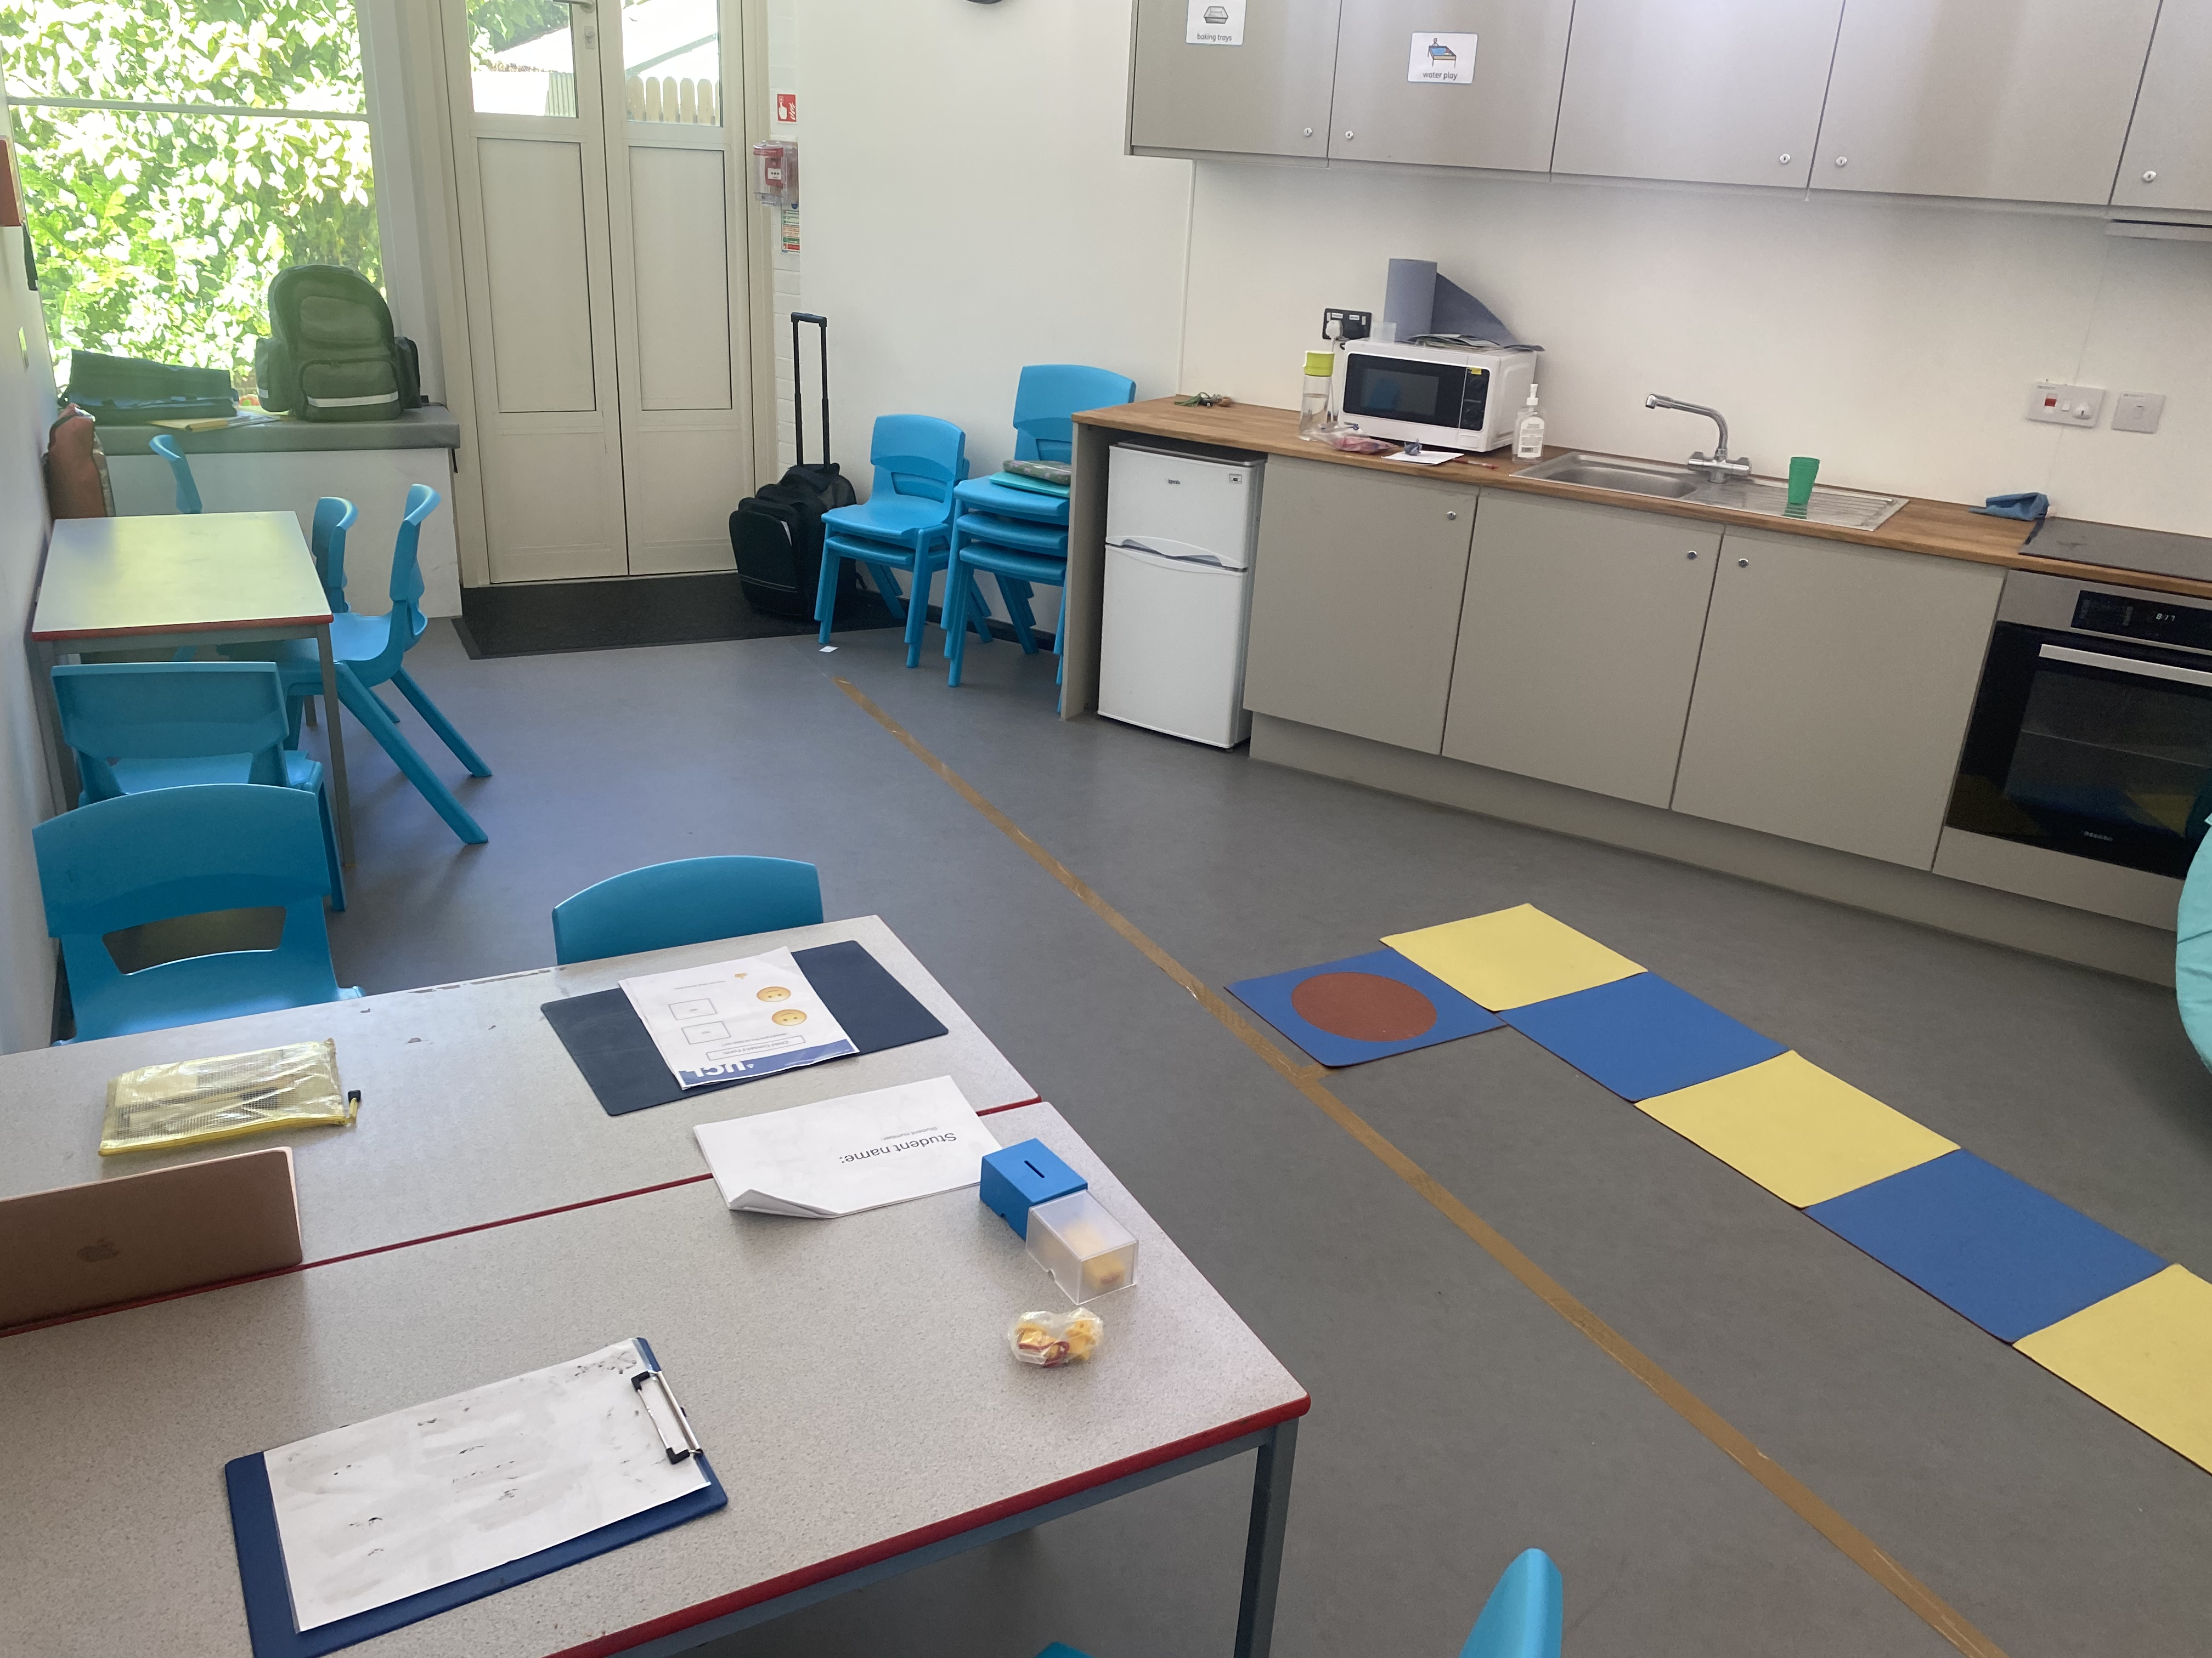
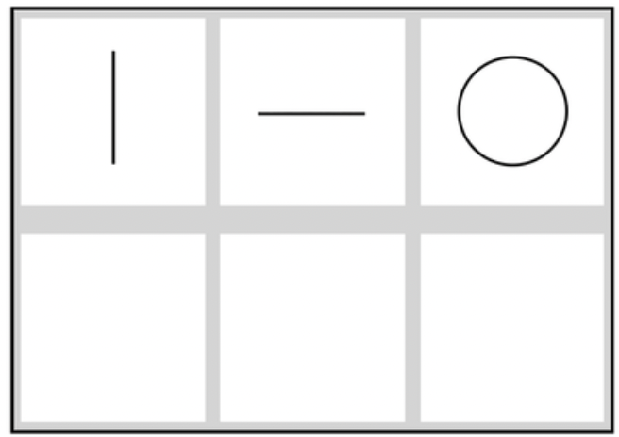
Methodology
Other measurements used:
motor abilities (MABC-2)
reading
Pictorial scale of perceived motor competence
Test of Visuo-Motor Integration
Notes:
When it came to actual data collection, we collected data from lots of different measures, but the ones i used in my study specifically were the PMSC, the beery VMI, the british abilities scales reading test as well as the MABC-2. As you can see in the photo i would lay everything out before-hand. Along with a whiteboard that was similar to that used in things like bucket time or class activities, that had a cartoon of each of the 3 tasks we’d be doing that session that i could tick off once we had finished each one
The PMSC was used because it has been used in studies of typically developing children of a similar age group, mainly by Lisa Barnett and colleagues who Spencer also spoke to whilst we were doing this study and was incredibly helpful. The pictorial element of the scale also helped when describing each movement to the children and made it i think more age appripriate.
The MABC, Beery VMI and reading have all been widely used with a broad age range of children within research, as well as in assessments done by occupational therapists within schools etc. and with autistic and other neurodivergent children
I repeated these measures for each child who was enrolled from college park, and then did the same for Hallfield

Slide 7
The research process
School integration
Piloting measures
15–20-minute sessions with each participant in a quiet room
Similar tasks grouped together for each session
Scoring and data analysis
Ethical approval
Reflective journalling
Notes:
I think spending that time just in the classroom made me so much more confident when it came to collecting data. I also felt a bit more like part of the team working with the children, which also is due to Estela being so welcoming of me into her classroom.
I learnt when were good times to do data collection with what child, how to explain things in a way they understood, how to watch for cues when maybe they didn’t feel comfortable, but most importantly, they knew who i was, i wasn’t as scary and we could have a bit of fun with it. I wasn’t just this weird adult who disupted their schedule, there was more of a level of trust there
Of course alongside improved the quality of data collection, as well as how much data we could collect, it also meant that i got to learn about how the autism schools run, what real struggles there might be that the teachers notice that can’t be learnt from lectures

Slide 8
Main findings
Significant group differences were found for all measures:
Motor; Reading; PMSC
Higher VMI score was associated with better word reading ability

Slide 9
Relationship between VMI and motor competence
A higher VMI score was associated with a higher score for motor competence

Slide 10
Relationship between perceived motor competence and actual motor competence
Higher perceived motor competence was associated with higher actual motor competence

Slide 11
The relationship between perceived motor competence and VMI
Higher perceived motor competence was associated with higher VMI scores

Slide 12
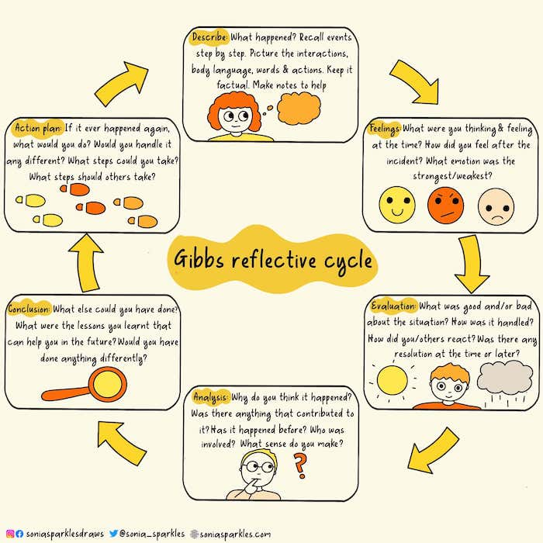
Reflective Practice
Reflecting after each session helped me understand what I was doing, how I was doing it, and identify areas of improvement.
It helped me see the project from a wider perspective.
Helped me understand my positionality as a researcher
Add gibbs cycle
Notes:
After each data collection session, I wrote down a little bit about how it went, how i felt and what i could do better. I did this using the Gibbs cycle framework, as shown here.
Firstly, reflecting after each session helped me understand what I was doing, how I was doing it, and how I could improve. As autism specialist schools are an ever-changing landscape, with new situations and behaviours arising every day, it felt important to reflect on how me being present and my work fit into that. In order to make reflect properly, I adopted the Gibb’s cycle approach which allowed me to look at each data collection day comprehensively through events, feelings, challenges and action plans for future days. For example, after the first day of piloting, I noticed because I was nervous that I was going through the tasks quite quickly, meaning I may have not used adequate time to explain and ensure the participants were settled. I also noticed that this may be because I hadn’t made a concise plan on what order to do tasks in and instructions for each. To ensure I could improve when starting data collection, I made a clearer plan for each participant, made sure all the testing materials were laid out clearly before they entered the room, and let the participants settle in for 5 minutes before commencing. This made the process go more smoothly. Reflecting on the process as a whole allowed me to feel more part of the process, including how different behaviours from children in the school impacted me, and how my responses impacted the entire situation.

Slide 13
What I learnt from being a researcher within the school system
How this has helped me now:
Utilising reflective practice/Gibb’s cycle in the workplace
Helping when working with children with complex needs within a hospital setting
Open communication with the schools prior to commencing data collection is vital and really helped make the process run smoothly
Forming a collaborative partnership between research and schools
Learnt invaluable skills that I can use in the future
Notes:
I think one of my key takeaways from acting as a researcher within schools is that building good communication from the start is really vital, and i am so grateful for the time estela, Lucy at Hallfield and all the teachers across the schools put in to help planning data collection with me. This meant that we could cause the least amount of disruption to their lessons and the children’s schedules. There were of course points when aligning and balancing schedules was really tricky, but reflecting on these challenges taught me how to be flexible and find solutions that worked for everyone
Because of this, i don’t believe data collection has to burden either the children or the teachers
It also allows us to see what is really important for the teachers, what they are seeing day to day and what they want to see being done in the world of research. In this way it grounds research in the actual practical realities you see day to day. You guys are the experts on what we are looking into and into the children who are participating and so having your input is invaluable !
And from our standpoint, the reason for doing this research is to directly benefit schools, teachers and of course the students, and I think i really got a sense of how that cyclical relationship can work
Going forward from this experience, i have been able to use a lot of of the skills and techniques i learnt within the school in my job. I see a lot of patients who are autistic, are disabled and have complex needs and i feel confident in communicating with them. Also i have used techniques i saw TAs use in the classroom to help calm them down and put them at ease, to make sure there is the lowest risk of any stress when coming into the clinic as possible
I think having the oppurtunity to work in the schools also just gave me that feeling of oh this is what i’m doing it all for

Slide 14
A huge thank you to all the schools !!!!
Notes:
And i just wanted to say a huge thank you to both College park and Hallfield for having me!

